Slide 1
Fit and Diverse: Set Evolution for Inspiring 3D Shape Galleries
Kai Xu^{1,2}, Hao Zhang³, Daniel Cohen-Or⁴, Baoquan Chen¹
¹Shenzhen Institutes of Advanced Technology (SIAT)
²National University of Defense Technology
³Simon Fraser University
⁴Tel Aviv University

Slide 2
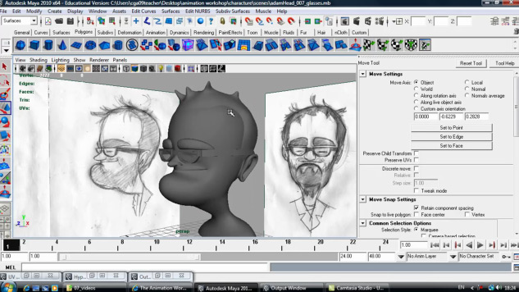
3D Modeling
3D content creation remains challenging
Creative 3D modeling is even harder
Open-ended process
Needs inspiration!
Notes:
As many other speakers have already mentioned, the creation of 3D content is a very important topic in computer graphics,
At the same time, 3D content creation remains challenging
Especially, to come up with a means for creative 3d modeling is even hard since the whole process is usually open-ended, the user has neither a clear goal, nor an existing model to start with
This kind of creative process often requires inspiration

Slide 3
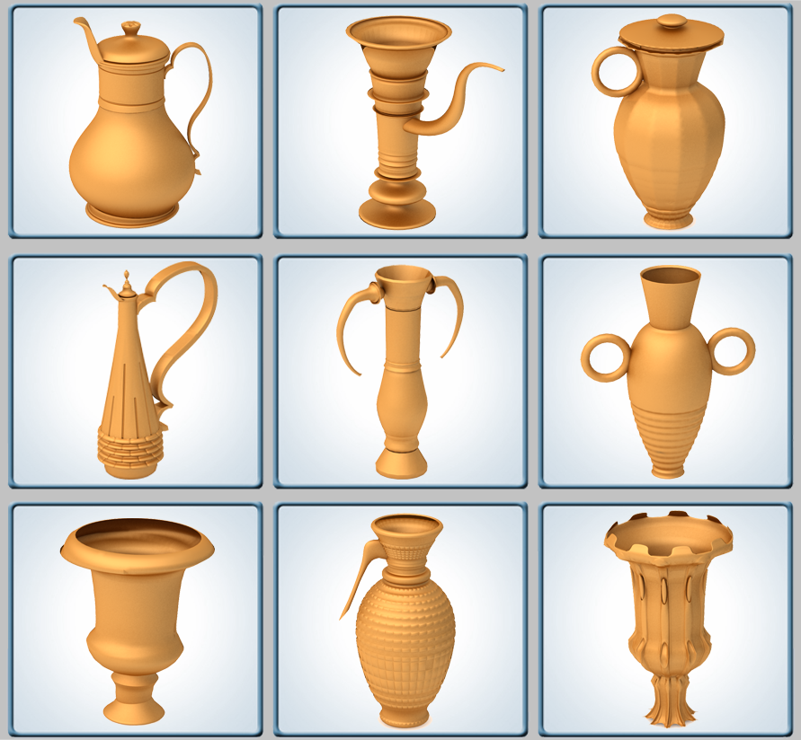
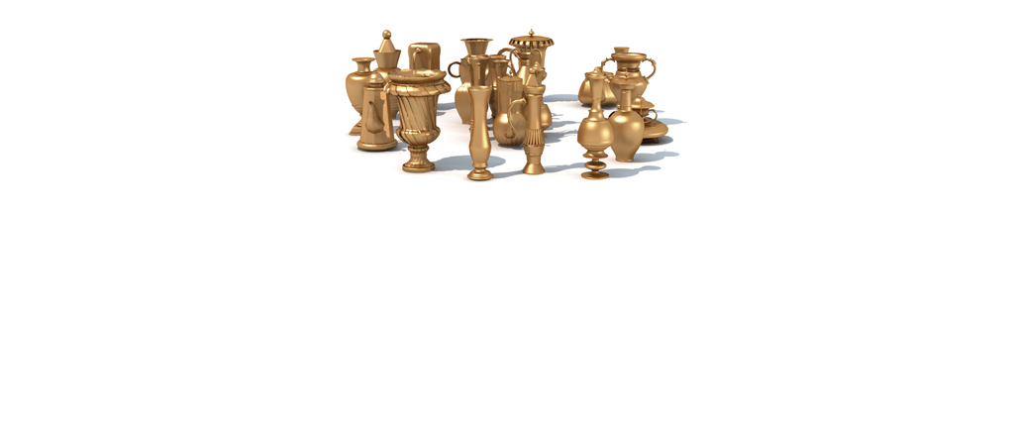
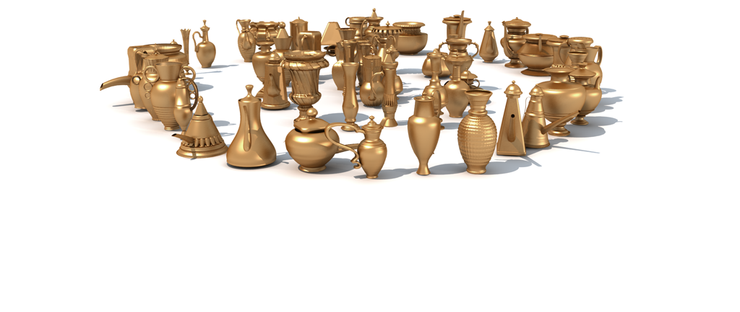
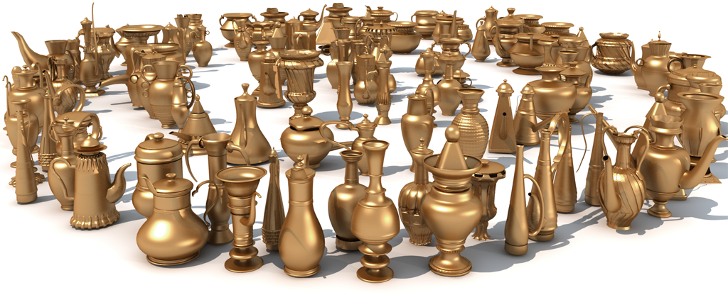
Inspiration from a set
Shape gallery
Notes:
In this work, we aim to provide the user with sets of complete shapes as modeling inspiration
This is achieved by example based shape synthesis
The newly synthesized shapes are suggested to the users with a shape gallery, so that the user can select the ones she likes
The user feedback can then be utilized by the system to improve the creative suggestion

Slide 4
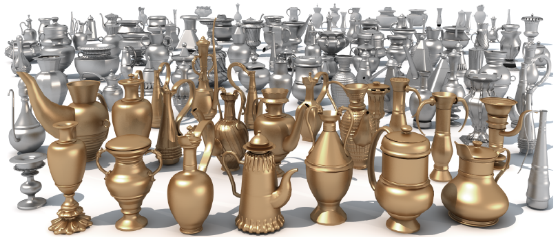
Synthesize sets of shapes …
Notes:
To provide sets of complete shapes as modeling inspiration, we need an approach that can automatically synthesize a set of shapes at a time

Slide 5
… via Set Evolution
Input: an initial population of 3D models belonging to a certain class
Evolve the entire population to generate sets of complete shapes as creative suggestions
Biologically motivated
Notes:
So we propose set evolution, which is motived by the biological evolution
Given a set of 3D models belonging to a certain class, we call it initial population,
we evolve the entire population to generate sets of offsprings, which are all complete shapes, as creative suggestion

Slide 6
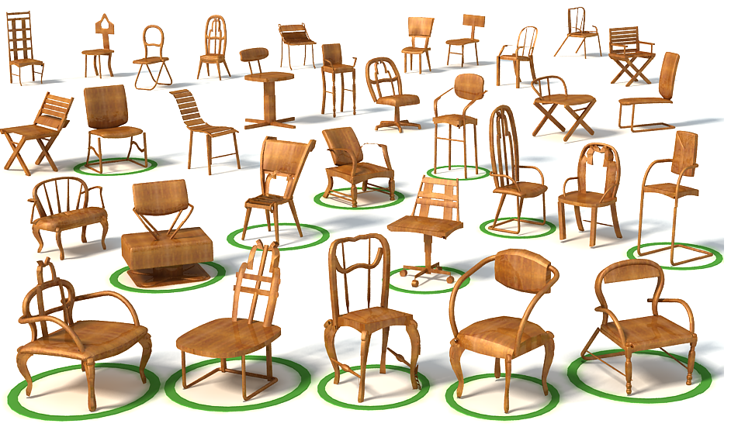
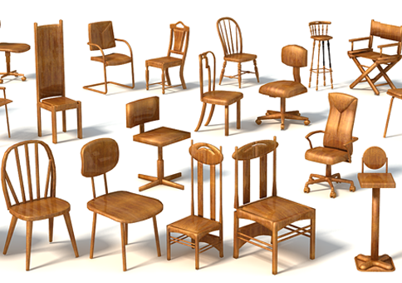
Shape synthesis via set evolution
The population should be fit
Reasonable
Input
Output
Notes:
Motivated by the principle of “survival of the fittest” from evolution theory,
we require that the population of 3D shapes should be fit
By fit, we mean that the generated shapes should be reasonable
Intuitively, if the input is a set of chairs, then the offsprings should also be chairs

Slide 7
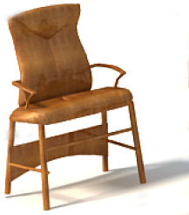
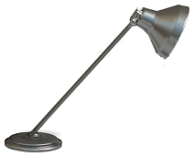
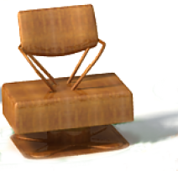
Shape synthesis via set evolution
How to evaluate fitness of an individual?
Computationally? hard
Objective
Subjective
☺
☹
Stand upright?
Notes:
So we need to consider how to evaluate the fitness of an individual
Unfortunately, it is very hard to computationally judge whether a shape is reasonable or not because it involves the analysis of functionality of man-made objects
So, we break the fitness into two aspects, objective and subjective.
Objectively, we simply estimate how likely the object is able to stand upright
In the subjective aspect, we resort to user evaluation. We let the user rate the shapes as liked and disliked.
One thing to note is that, this subjective likedness may reflect both reasonableness and the user’s preference

Slide 8
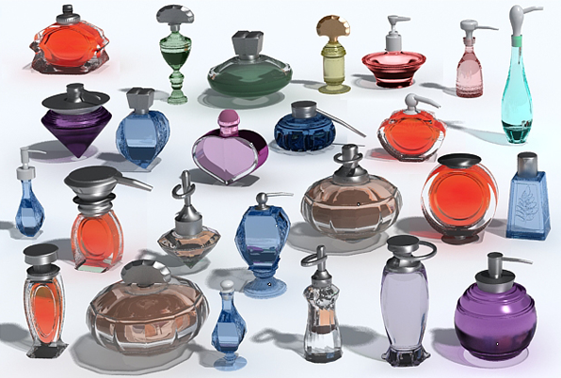
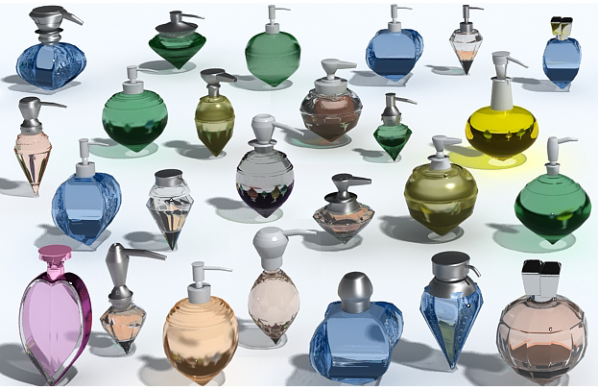
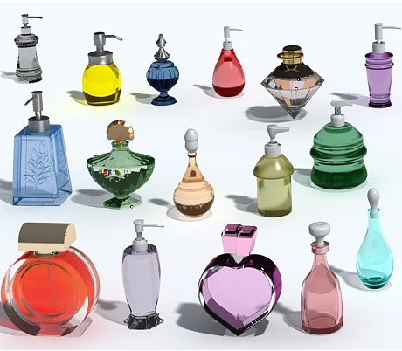
Shape synthesis via set evolution
The population should be fit AND diverse
Unexpected, yet interesting → Inspire creativity
Input
Fit and diverse
Elite
Notes:
Actually we hope the evolving set is not only fit but also diverse.
In particular, we hope the evolving set should contain sufficient unexpected yet interesting shapes so that the user can draw modeling inspiration from the sets
Taking the perfume bottles here for example, this is the result that is fit and diverse
In contrast, if our system does not maintain diversity, when the user always likes heart- or diamond shape bottles, the experiment shows that the evolution will lead to an elite population

Slide 9
Fit and Diverse
Unexpected individuals (diverse) within expected species (fit)
Notes:
Generally speaking,
The requirement of fit and diverse implies that the evolution should generate as many as possible unexpected individuals within the expected species

Slide 10
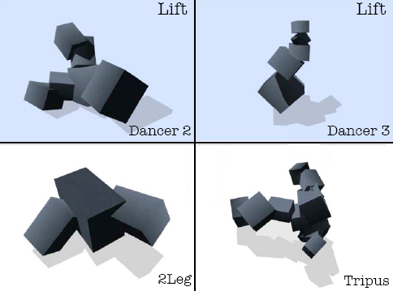
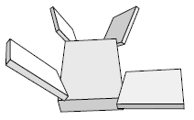
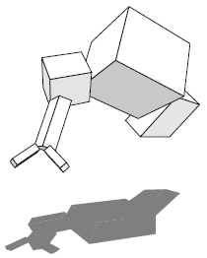
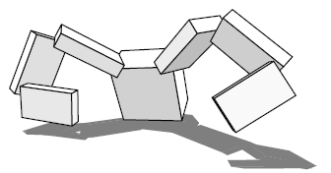
Related works
Evolutionary modeling and design
[Sims 1991,1994]
[Pilat and Jacob 2008]
Notes:
The idea of evolution has been brought into computer graphics for many years.
The most important difference of our work from these previous ones is, our method evolves a set of 3D shapes.

Slide 11
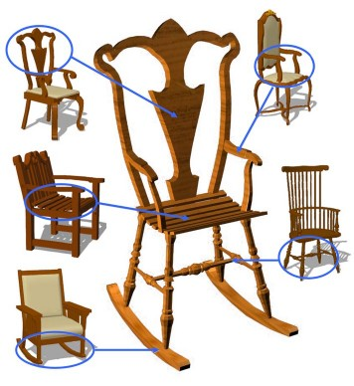
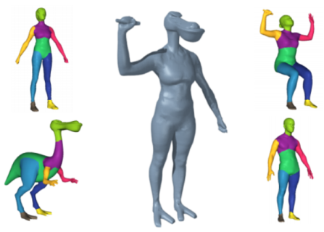
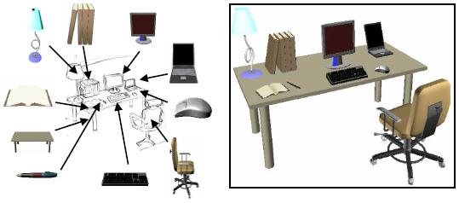
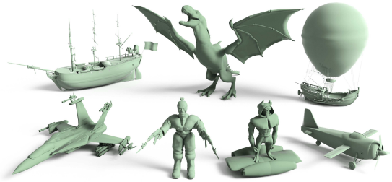
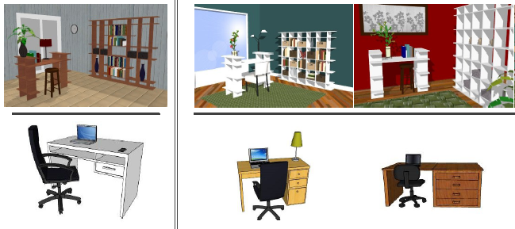
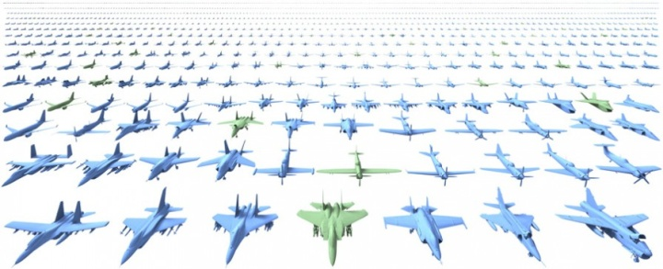
Related works
Data-driven shape modeling
[Funkhouser et al., 2004]
[Kraevoy et al., 2007]
[Shin and Igarashi 2007]
[Chaudhuri et al., 2011]
[Fisher et al., 2011]
[Kalogerakis et al., 2012]
Notes:
Also related to our work is data-driven shape modeling, which is recently a very hot topic in computer graphics.

Slide 12
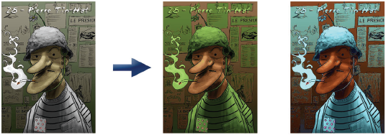
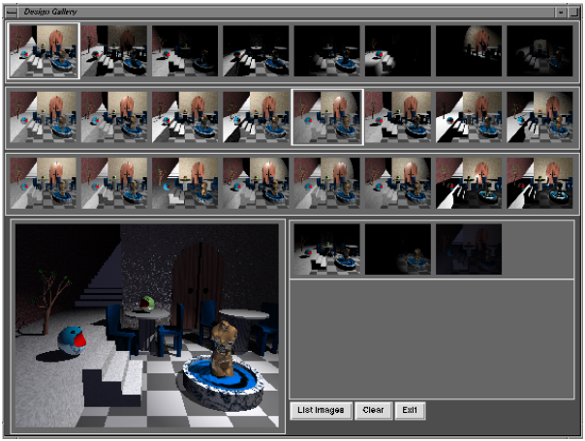
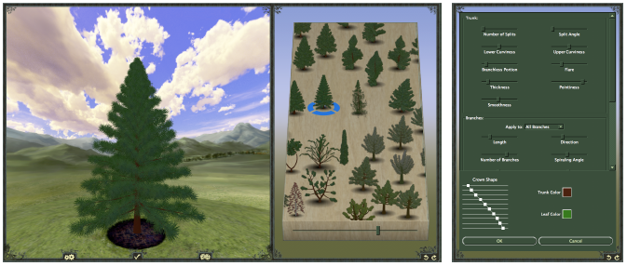
Related works
Design space exploration
[Shapira et al., 2009]
Design Galleries
[Marks et al., 1997]
[Talton et al., 2009]
Notes:
Our work is also inspired by the seminar work of design galleries.
We utilize a shape gallery to help the user to explore the design space of man-made objects.

Slide 13
Set evolution: System overview
Initial population
Check stand
Current
generation
Reproduction
New shapes
New shapes
Shape gallery
User
Notes:
Here is an overview of our system.
Starting from the initial population, we repeatedly generate new shapes from the current generation, through a reproduction process
The newly generated shapes are filtered by the upright standing criterion, and then presented to the user in a 3D shape gallery.
The user can affect the evolution by rating the new shapes. The rated shapes are then merged into the whole population to join in the reproduction in the next round.

Slide 14
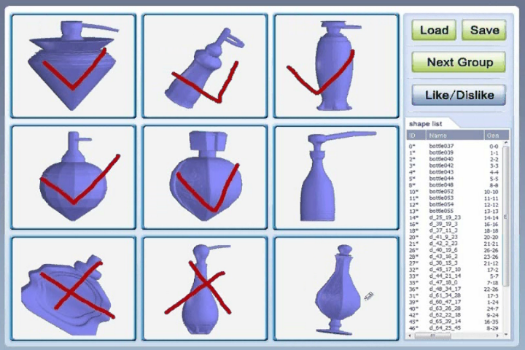
Interactive set evolution: like or dislike
A snapshot of UI
Notes:
This is a snapshot of the user interface of our system.
Our system presents 9 shapes at a time to the user and allow her to rate the shapes as liked or disliked
Liked shapes will have higher chance to reproduce.

Slide 15
Set evolution: System overview
Initial population
Background
Reproduction
Current
generation
New shapes
Shape gallery
Foreground
Diversity control
User
Notes:
To keep the amount of computation and user interaction in each generation manageable,
We should only allow a relatively small set to participate the reproduction
So we need to consider how to maintain a relatively small breeding set while keeping diversity,
To this end, we split the whole population into two disjoint subsets: a large background set and a smaller foreground set
The foreground set contains shapes breeding to produce new generations.

Slide 16
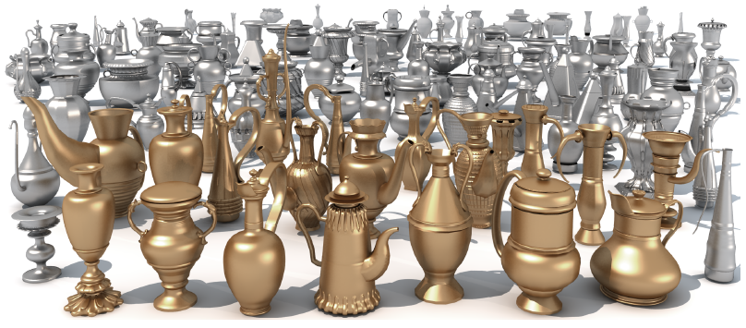
Diversity control
Background set
Foreground set
Notes:
The rest of the population is in the background set, which is kept for the sake of diversity.
In each generation a controlled portion of the background set is upgraded and included in the foreground set, to introduce more diversity into the breeding set.

Slide 17
Set evolution: System overview
Initial population
Background
Reproduction
New shapes
Shape gallery
Mutation
Crossover
Foreground
Crossover
User
Notes:
Now let’s take a look at the core part, reproduction.
The reproduction contains two genetic operators: mutation and crossover, which are the key to generate shape variations
We will spend a bit more time on the crossover operator since it is a major operation of the reproduction process

Slide 18
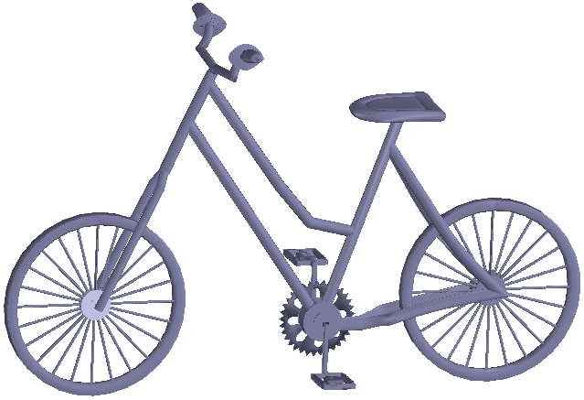
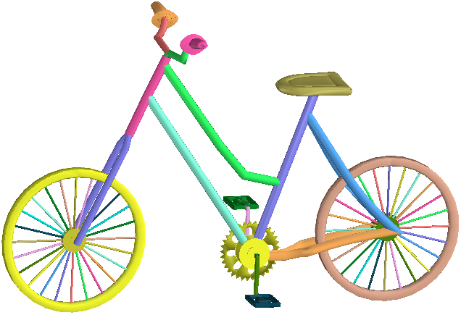
Reproduction: Basic setting
Work on the finer-level parts
71 components
Notes:
Our reproduction works on the finer level parts, that is, the individual components of a man-made shape
For example, this bicycle model is composed of seventy one components

Slide 19
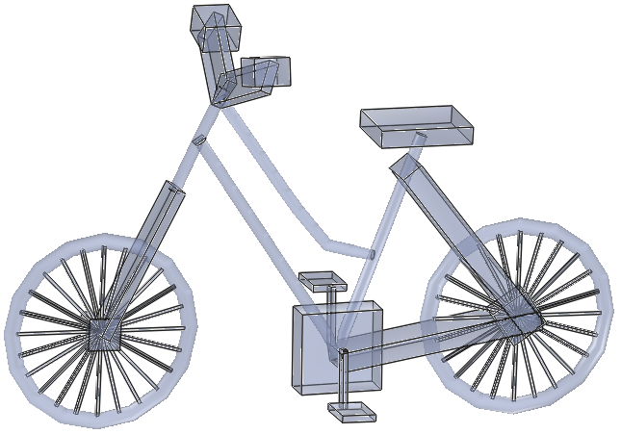
Reproduction: Basic setting
Component-wise controllers [Zheng et al. 2011]
71 controllers
Notes:
To accommodate the part alternation caused by mutation and crossover, we adopt the component-wise controllers as the means for structure-aware deformation

Slide 20
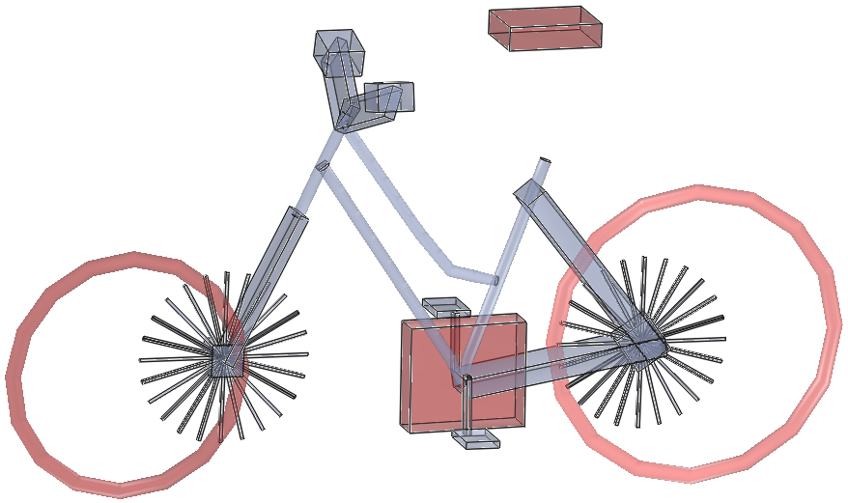
Reproduction: Basic setting
Component-wise controllers [Zheng et al. 2011]
Multiple controllers altered

Slide 21
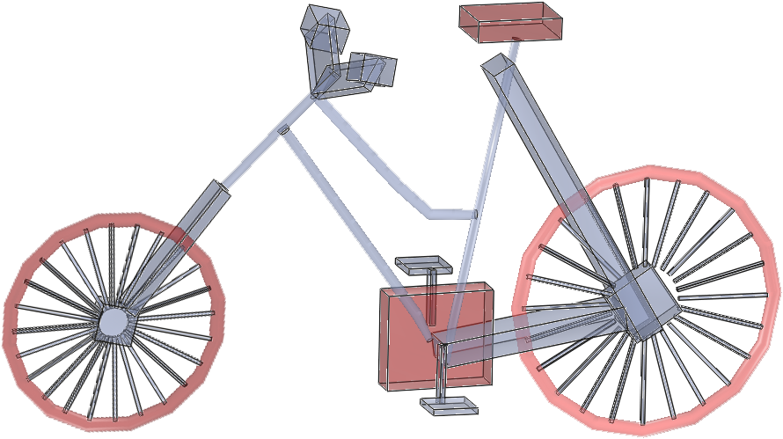
Reproduction: Basic setting
Component-wise controllers [Zheng et al. 2011]
Structure optimization
Notes:
This is the resulting controllers by structure optimization

Slide 22
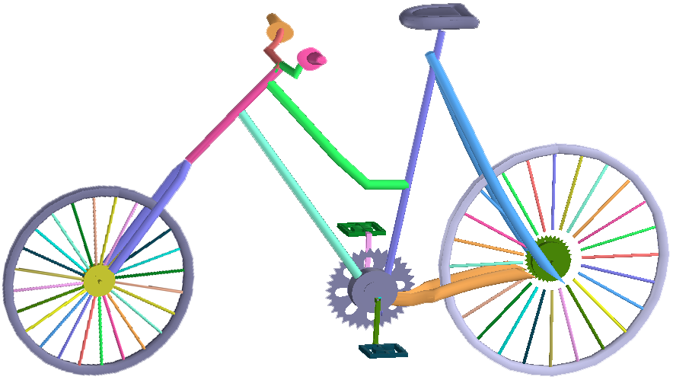
Reproduction: Basic setting
Component-wise controllers [Zheng et al. 2011]
Final result

Slide 23
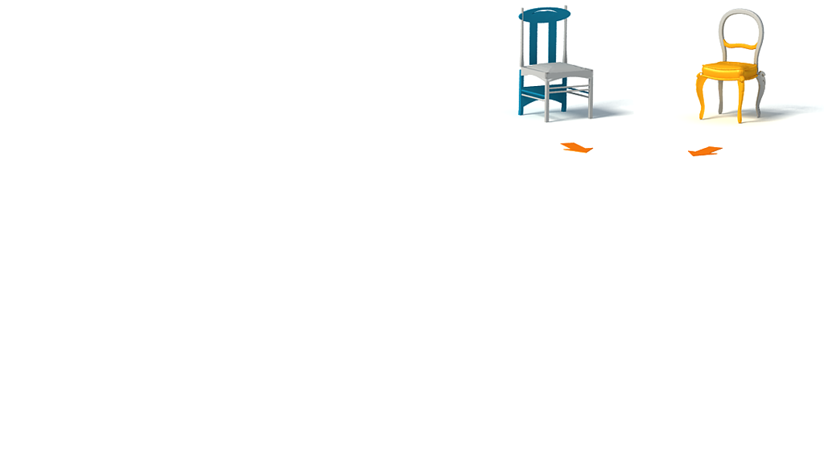
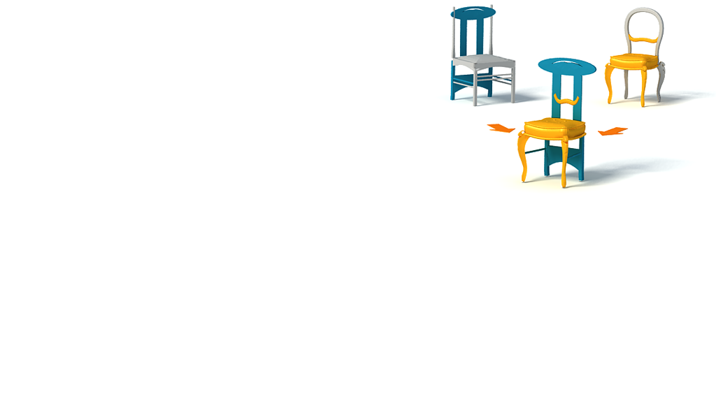
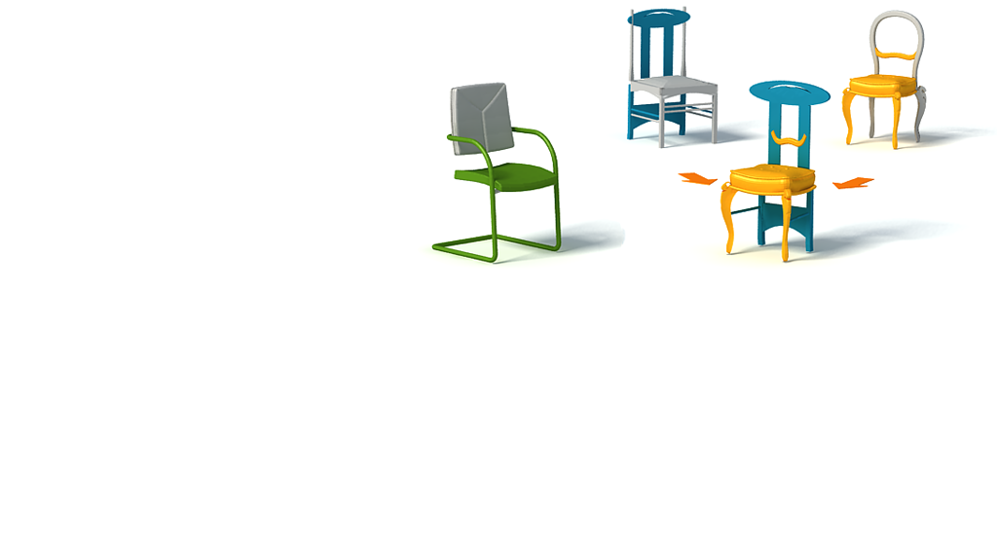
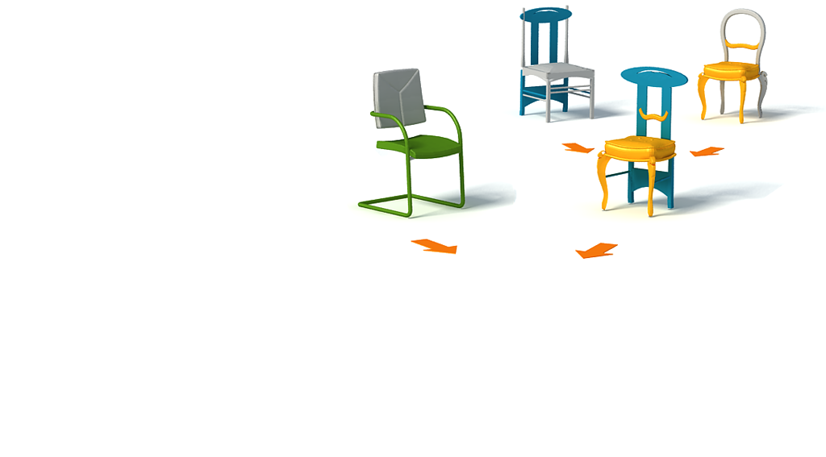
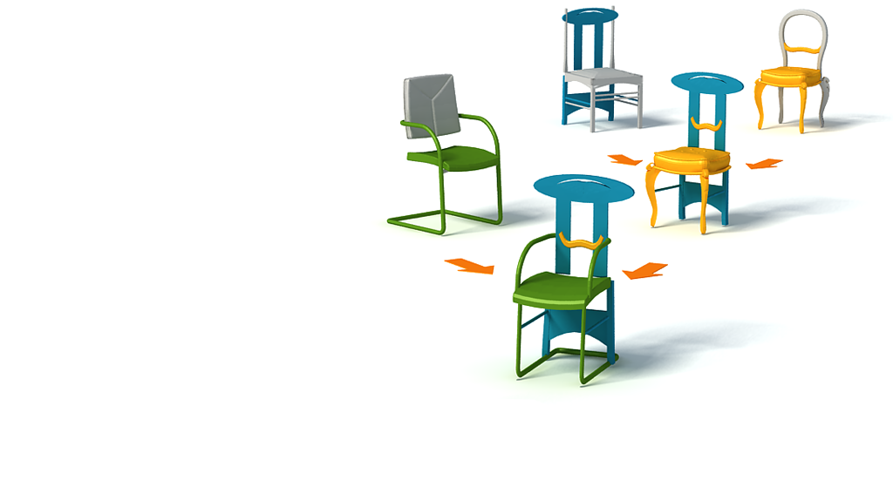
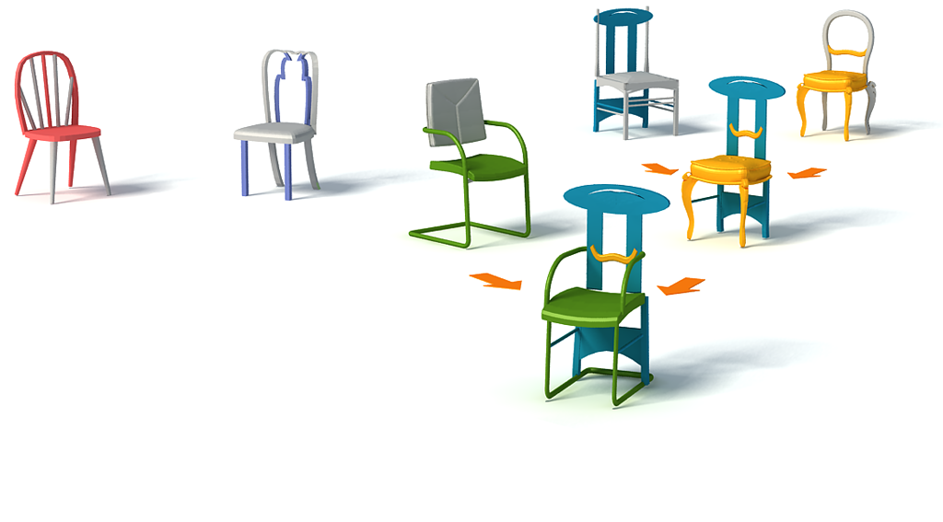
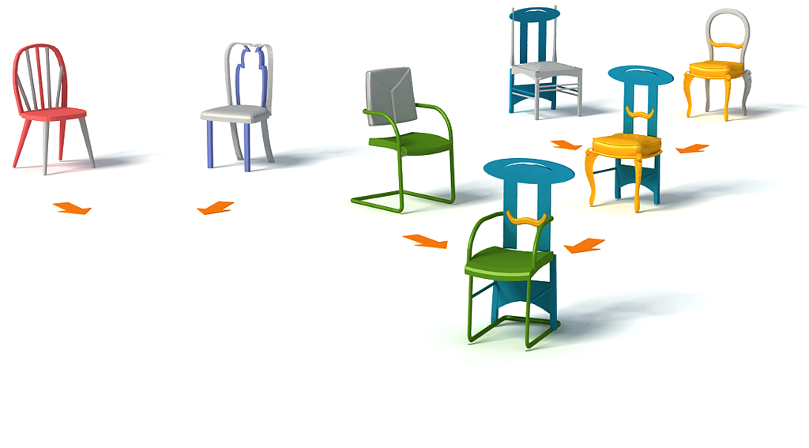
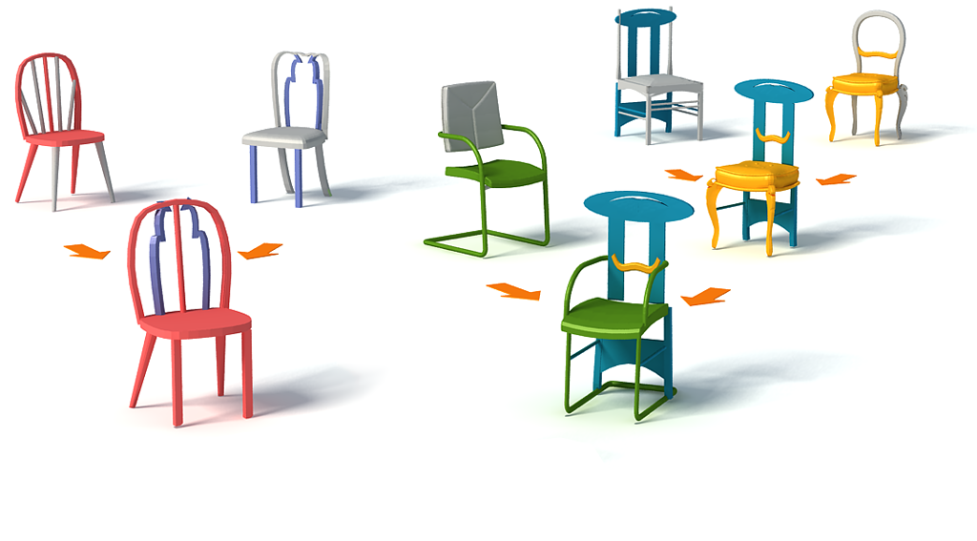
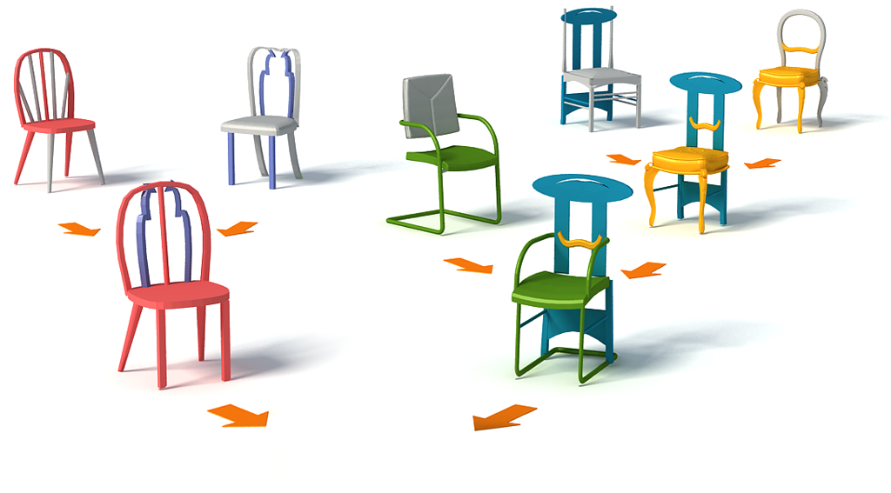
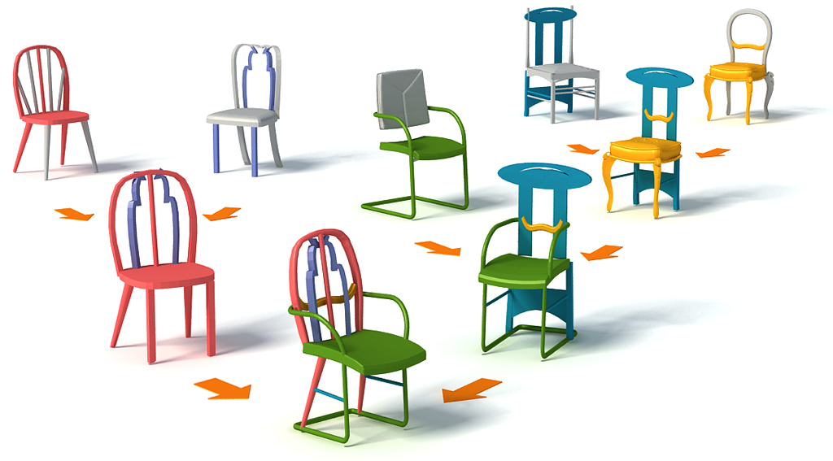
Reproduction: Crossover
Notes:
Basically, the crossover is a part recombination between two parent shapes

Slide 24
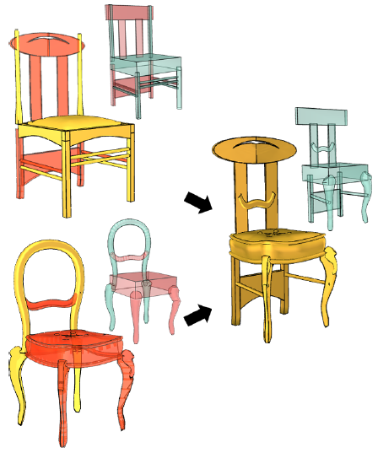
Reproduction: Crossover
Two key problems:
Select proper subsets of parts
Assemble the selected parts
Notes:
To generate as many as possible individuals that are reasonable or fit, we need to perform the part recombinations in a reasonable manner
To this end, we need to solve the following two key problems:
How to select proper subsets of parts from both the two parent shapes.
The second one is how to assemble the selected parts to form a complete shape
Solving these two problems for man-made objects is definitely not a trivial task.
But if we have part correspondence in hand, the problems can be made much easier.

Slide 25
Reproduction: Crossover
Correspondence for finer level parts?
?
?
?
?
ill-posed problem!
Notes:
So can we compute part correspondence?
Unfortunately, finding exact correspondence for finer level parts of man-made objects is an ill-posed problem
So we opt to find a fuzzy part correspondence

Slide 26
Reproduction: Crossover
Fuzzy Part Correspondence (FPC)
Part proportion normalization [Xu et al. 2010]
Global alignment
Part proportion normalized
Globally aligned
Two 2D chairs
Notes:
This is how we compute fuzzy part correspondence… which is actually simplistic
Given two shapes, we first remove their discrepancy in part proportion using the method style content separation
Then we perform global alignment for the two shapes
The fuzzy part correspondence between every two parts from the two shapes is simply computed as the Hausdorff distance between their bounding boxes

Slide 27
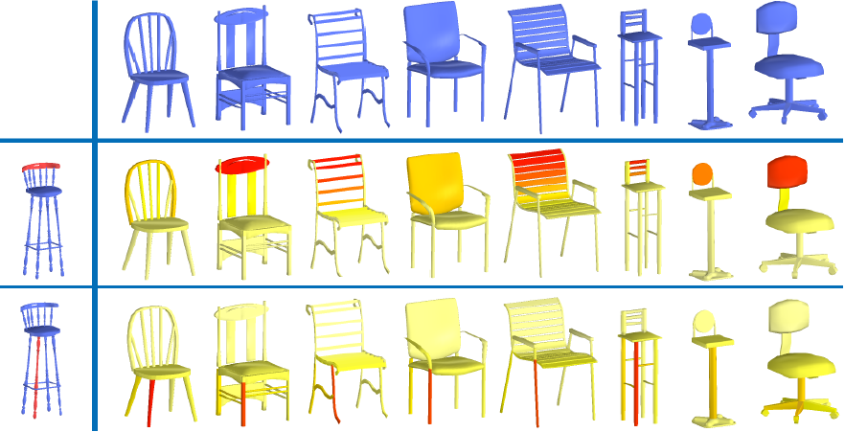
Reproduction: Crossover
Fuzzy Part Correspondence (FPC)
Confidence of part replacement
Notes:
Here is a color-coded visualization of fuzzy part correspondence, or FPC
The red parts highlighted in the left most column are the queries
The FPC scores of the parts in the other shapes are shown in the right, where red corresponds to larger FPC value and yellow means small

Slide 28
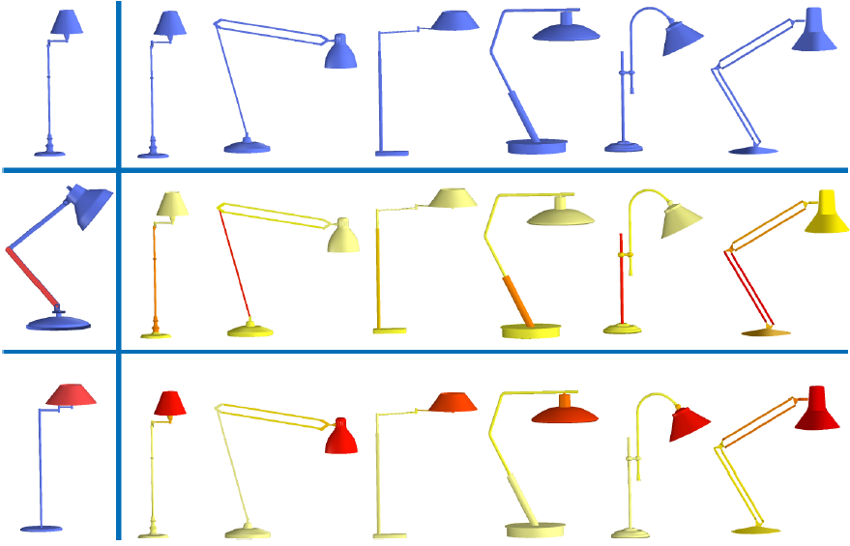
Reproduction: Crossover
Fuzzy Part Correspondence (FPC)
Confidence of part replacement
Notes:
As you can see, the FPC roughly reflect the semantic part correspondence

Slide 29
Reproduction: Crossover
Two key problems:
Select proper subsets of parts
Assemble the selected parts
Notes:
With the fuzzy part correspondence in hand, let’s come back to the two problems:
Let’s first take a look at how to select proper subsets of parts

Slide 30
Reproduction: Crossover
How to select the subsets of parts?
Avoid spatially large overlap
Preserve symmetry constraints
Cover all the semantic parts
Notes:
To select the proper subsets to form a complete shape,
We consider three criteria:
First, the parts selected should not have large spatial overlap, to avoid duplication of parts. For example… This is achieved with the help of fuzzy part correspondence we just described.
Second, we preserve the symmetry constraints during selection, e.g., if a part is selected, its symmetric counterpart should also be selected.
Third, the parts selected from the two parents must collectively cover all the sematic parts. For more details about this criterion, please refer to the paper.

Slide 31
Reproduction: Crossover
Two key problems:
Select proper subsets of parts
Assemble the selected parts
Notes:
Having selected the subsets of parts,
The next task is to assemble the selected parts to build a complete shape

Slide 32
Reproduction: Crossover
Context-based part placement
Progressively place parts from source shape into target
Already placed parts serve as context/constraints
?
?
?
Source
Target
Notes:
This is achieved by context based part placement
Here is an example, the parts marked in red in both shapes are those selected to construct the new shape
We progressively place the selected parts in the source shape into the target
The already placed parts serve as context or constraints for the following parts.

Slide 33
Reproduction: Crossover
Structure optimization
Preserve mutual relations inherited from parents
Source
Target
Notes:
During the placement, the parts are deformed to preserve the mutual relations inherited from the parents.

Slide 34
Context-based part placement
Notes:
Here we show the whole process of the context based part placement

Slide 35
Source
Target
Crossover controllers
Resulting controllers
Boundary controllers
Place boundary controllers
Place other controllers
Notes:
We first identify boundary parts in the source shape,
which are the parts that are not selected but neighboring to those selected parts, as shown in yellow
We first deform the boundary parts to fit their counterpart in target found by a fuzzy part correspondence which we have just described.
Then other parts are placed in the descending order of confidence, which is also computed based on fuzzy part correspondence

Slide 36
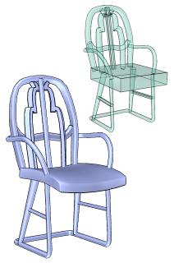
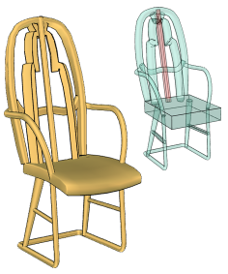
Reproduction: Mutation
Part warping based on the controller setting
Notes:
OK, we have talked about crossover, one of the two reproduction operators. Now let’s take a look at the other one, mutation,
Mutation is achieved by part warping, which is rather easy to implement using controllers
Specifically, we randomly choose a controller and warp it, the deformation is propagated to all the other controllers in a structure-aware manner, resulting a warped shape

Slide 37
Reproduction: Mutation
Deformation of a part is learned from the input set
[Ovsjanikov et al. SIGGRAPH 2011]
Notes:
The allowed deformation of a part is sampled from a statistical model learned from the input set.

Slide 38
Results
Chair set
Input set
The 5th generation
The 15th generation
The 10th generation
Notes:
Now we show some results of set evolution
This is an input set of chairs
This is the chairs generated in the 5th gen … the shapes that are marked with a green circle are those recognized by our participants as unexpected
this is the result in the 10th gen … as you can see, there are indeed quite a few chairs with novel, yet meaningful structures

Slide 39
Results
Candelabra set
Input set
The 15th generation
The 10th generation
The 5th generation
Notes:
This is the candle set

Slide 40
Results
TV-alien set
Input set
Notes:
Here we show an unfamiliar set. We asked our artist to model a set of creatures we call TV aliens as the input population and see if our method can generate something interesting
Here are the generated shapes, you may see, our method can indeed generate some creatures that are interesting, even funny looking but actually reasonable

Slide 41
Results
Elite set: cat-like creatures!
Notes:
If without diversity control, the evolution leads to an elite set when the user always liked creatures with a big head and short legs, we call them cat-like creatures

Slide 42
Limitations
Reproduction operators
Limited by the underlying structure representation: part-based
Diversity
Limited to the shape signature
Unreasonable results
Heuristic nature of the part selection in crossover
Notes:
Still, our work has the following limitations,
First, our reproduction operators are limited by the underlying structure representation, currently it is simply a part recombination
Secondly, the diversity is measure by shape signature, more advanced measure can be employed
Thirdly, our method still can generate unreasonable results, mainly due to the heuristic nature of the part selection in crossover. Here learning a statistical model might be a good way out

Slide 43
Discussions
Not evolution in the nature
From primitive into advanced?
Notes:
We want to highlight that our set evolution is not an evolution from primitive shapes into advanced ones, like the evolution in the nature.
Developing such kind of evolution for 3d shapes might be interesting to investigate

Slide 44
Discussions
Initialize with a sufficiently “developed” set
High-level structural information
Interesting direction: low level “shape DNA” that can evolve!
?
Notes:
Another thing is that,
Our set evolution is initialized with a sufficiently “developed” set
Specifically, the shapes in the initial population have been pre-analyzed to possess high level structural information, such as part corr.
An interesting direction would be developing a low level shape DNA that can evolve, this way, the evolution would better conform to the conventional genetic algorithm
and may be able to generate even more unexpected shapes

Slide 45
Discussions
Possible future works:
Evolving sets belonging to different but relevant classes?
co-evolution?
Notes:
Another possible future direction is evolving sets of shapes belonging to different but relevant semantic classes
For example, can we evolve a set of tools so that they together fulfill some kind of task?
This may be correlated to the notion of co-evolution

Slide 46
Thank you!
Notes:
With that, thank you for your attention.

Slide 47
A preliminary user study
Diversity control over unexpectedness
Notes:
Here is the effect of diversity control over the unexpectedness of the shapes created in various generations
The unexpectedness is rated by a group of users
The plots show that without diversity control, the unexpectedness does decline over the generations

Slide 48
Statistics & timings
Notes:
The input population usually contains tens of shapes
The reproduction of one shape takes about less than a second
Our reproduction can sometimes produce invalid shapes, the last column reports the percentage of valid. As you can see, the more complex the structure of the shape class, the less percentage of validness we get. The validness is rated by the a group of users, since automatic evaluation of validness of a man-made shape is rather challenging.

Slide 49
Diversity control
Background set
# = 120
Background set
Foreground set
# = 40
80%
Foreground set
Reproduction
15%
5%
Generation i
Generation i+1
Notes:
Let’s take a look at the flows between the two sets from one generation to the next.
The foreground usually maintains 40 models and the background contains 120
The foreground set breeds into the next generation through reproduction.
So in the next generation, the foreground set is composed of the shapes 80% from reproduction, 15% from the previous generation, and 5% from the background set.
The background set is composed of shapes both from reproduction and from itself in the previous generation.

Slide 50
Compare to [Kalogerakis et al., 2012]
[Kalogerakis et al., 2012] | Ours
Learning a graphical model | Assembly at finer level parts

