Slide 1
Layered Analysis of Irregular Facades via Symmetry Maximization
Hao Zhang, Kai Xu, Wei Jiang, Jinjie Lin, Daniel Cohen-Or, Baoquan Chen
Shenzhen Institutes of Advanced Technology
National University of Defense Technology
Simon Fraser University
Tel Aviv University

Slide 2
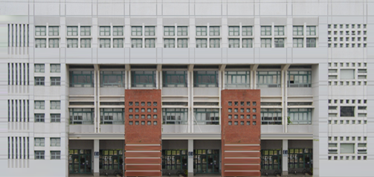
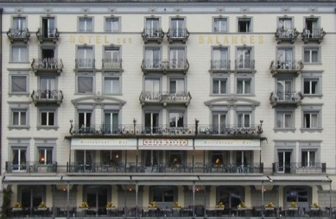
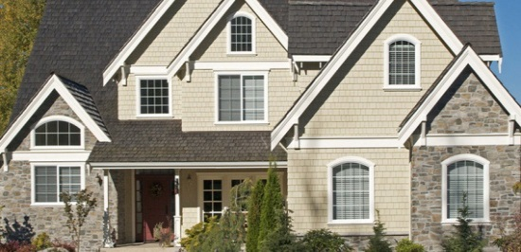
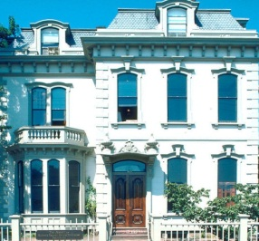
Façade
Rich interesting structure to analyze
Notes:
Well, the basic building blocks of facades are mainly regular grids of windows or balconies, however, real-world facades often exhibit rich variety because they are mostly composed of irregular mixtures of grid structures.

Slide 3
Our goal
A high-level understanding of the structure of irregular facades
A generative model
An explanation of how the input facade was seemingly generated
Decomposition
Layering
2. Instantiation
Split
Notes:
So in this work, we are interested in high-level understanding of the structure of irregular facades
The output of our analysis is a generative model which represents an explanation of how the input façade was seemingly generated
Here is a example, given a building façade. Lets now start with its bounding box, we recursively perform binary decomposition over the empty boxes,
Where the decompositions include layering, and splits.. Finally, we instantiate the finest-level boxes by regular grids of image content, we obtain the original façade image

Slide 4
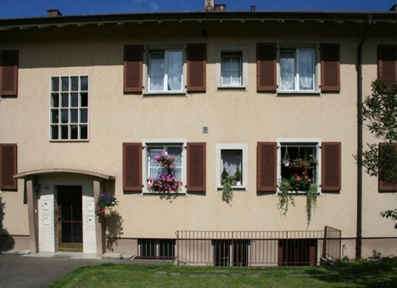
Generative model
A hierarchy of decompositions
Notes:
So essentially, our generative model is a hierarchy of decompositions
To obtain the hierarchy, we first abstract the façade elements, like windows, balconies, etc., as rectangular boxes, leading to a box pattern. Then we recursively decompose the box pattern until all the substructures are regular grids, which can not be decomposed further. This results in a binary tree of decompositions.

Slide 5
Generative model
Two decomposition operations: split + layering
+
Input
Split
Two substructures
Notes:
We have two decomposition ops.: split and layering. Given a box pattern, a split divides it into two non-overlapping substructures.

Slide 6
Generative model
Two decomposition operations: split + layering
+
Layering
Input
Two substructures (layers)
Structure completion
Notes:
A layering, on the other hand, splits a flat structure, along the depth direction, into two overlapping layers
And for the bottom layer, we perform a structure completion to convert the substructure into a regular grid

Slide 7
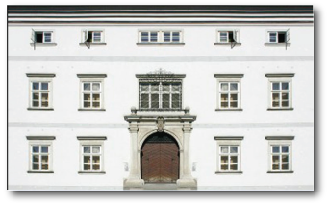
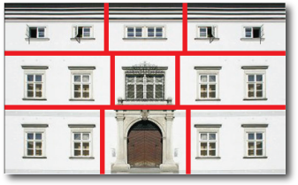
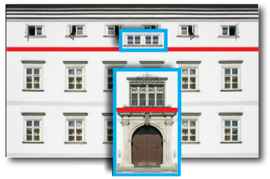
More compact generative model
Two decomposition operations: split + layering
input
split only
8 ops.
split + layering
4 ops.
Notes:
Having layering be considered leads to a more compact generative model. Taking this façade image for example, if we use only splits, we need eight operations to split it into nine regular grids. In contrast, if we use both split and layering, we need only four operations.

Slide 8
A good generative model
Two objectives
Structural: Occam’s Razor
(Simplest explanation)
min. # ops.
Notes:
So we come to the question that what a good generative model is..
As a generative model, we naturally require that the model is as compact as possible. According to the principle of Occam’s Razor, we seek for the simplest explanation
In our case, we can simply minimize the number of decompositions

Slide 9
A good generative model
Two objectives
Structural: Occam’s Razor
(Simplest explanation)
Perceptual: Law of Gestalt (Symmetry maximization)
Two substructures are most symmetric!
The two objectives can be optimized simultaneously.
Symmetry maximization → decomposition terminates the fastest
Notes:
On the other hand, we have another objective which is more perceptual, i.e., according to the law of gestalt, we hope each decomposition maximizes the symmetry of its two substructures
Interestingly, we find that the two objectives can actually be optimized simultaneously. Here is an intuitive explanation. Since our decomposition stops when all substructures are regular grids, which are maximally symmetric, symmetry maximization will drive the decomposition terminate the “fastest”, which requires the minimum number of decompositions

Slide 10
Symmetry-driven analysis
Symmetry maximization at each decomposition
How good is the decomposition?
How symmetric are the two substructures?
Notes:
So for a given box pattern, we can evaluate the goodness of a decomposition in terms of symmetry maximization, i.e., we measure how symmetric the two substructures are.

Slide 11
Symmetry-driven analysis
Objective: sum of symmetry measure of all internal nodes
$$S_{1}$$
$${max. Σ=S_{1}+S_{2}+S_{3}+S}_{4}$$
$$S_{3}$$
$$S_{2}$$
$$S_{4}$$
Notes:
Now for the entire hierarchy, we can define the goodness of the hierarch, or the objective function, by summing up the symmetry measures of all internal nodes

Slide 12
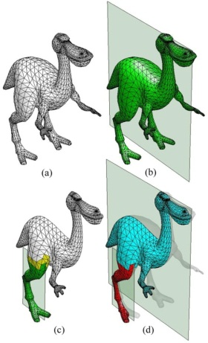
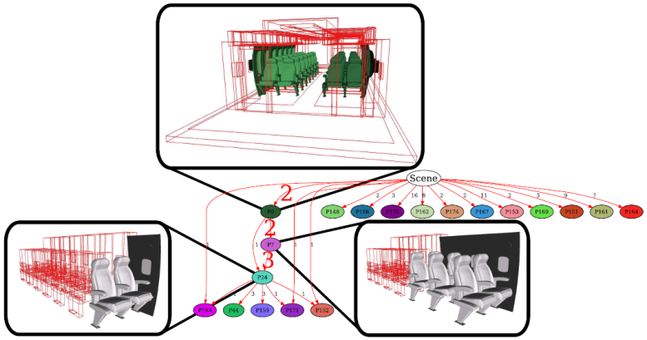
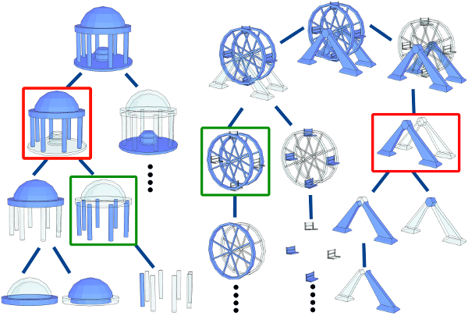
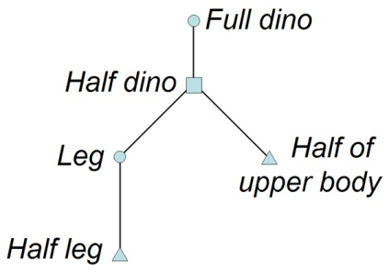
Related works
Structuring symmetry
Folding mesh
[Simari et al. 06]
Structuring 3D Geometry
[Martinet 2007]
Symmetry hierarchy
[Wang et al. 2007]
Notes:
In retrospect, symmetry has long been playing an important role in structural analysis of 3D models or 3D scenes
In this work, we steer symmetry for façade structure analysis

Slide 13
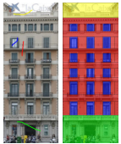
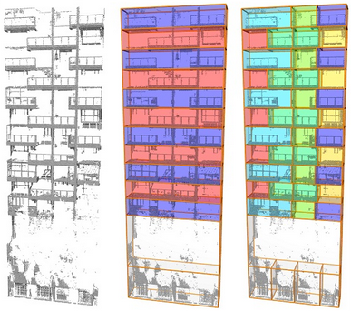
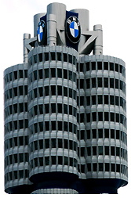
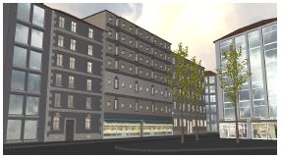
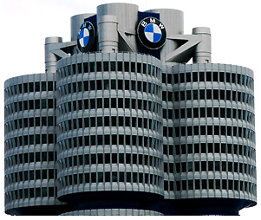
Related works
Façade analysis
Instant architecture
[Wonka et al. 2003]
Symmetry-summarization
[Wu et al. 2011]
Shape grammar parsing
[Teboul et al. 2011]
Adaptive Partitioning
[Shen et al. 2011]
Layering has so far not been considered.
Notes:
Existing works on facade analysis mostly focus on regularity detection or flat segmentation of facades..
Hierarchical segmentation of facades has been studied but only with split considered. Layering has so far not been considered in their analysis

Slide 14
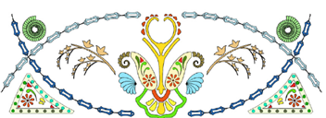
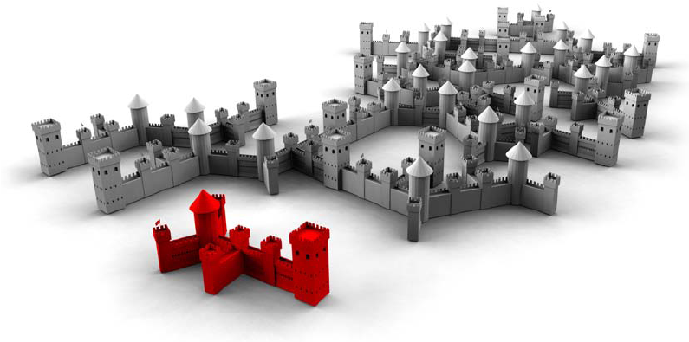
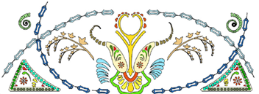
Related works
Inverse procedural modeling
Inverse L-system
[Stava et al. 2010]
Partial symmetry and inverse procedural modeling
[Bokeloh et al. 2010]
We do not produce a shape grammar.
Notes:
Also related is inverse procedural modeling, aiming to recover a shape grammar from an example shape or structure.
But our method produces a hierarchical representation, rather than a shape grammar.

Slide 15
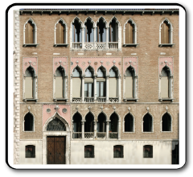
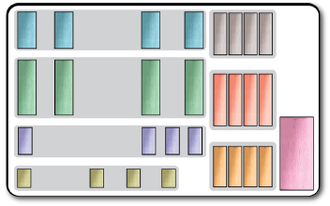
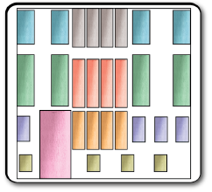
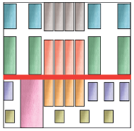
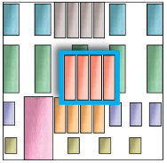
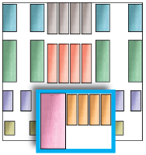
Overview – Key components
Element groups
…
…
…
…
Hierarchy optimization
Box abstraction
Candidate selection
Notes:
Let’s now take a look at the key components of our façade analysis
Our method starts with a box abstraction of the input façade image,
Then we extract a set of element groups, which are either complete or incomplete regular grids.
Based on these element groups, we select for each substructure a set of candidate decompositions which are used to construct the hierarchy via optimization

Slide 16
Interactive box abstraction
Notes:
Let’s first take a look at box abstraction.. This actually involves labeled segmentation of façade images.. However,
Automatic façade segmentation is a very hard problem and is not our focus. In our work, we developed an interactive tool for box abstraction. Here is a video of the interactive box abstraction. The user draws a tight box over a seed element, then our method can automatically search for similar enclosed content over the entire image.

Slide 17
Element groups
A set of well-aligned boxes whose content repeats
Must be maximal: not contained by any other one
Notes:
With the user labeled boxes, we detect element groups which are a set of well-aligned boxes whose content repeats. These element groups are either complete or incomplete regular grids. A single element can form a regular grid on itself if it can not find a symmetric counterpart.
We require that an element group must be maximal, meaning that one group is not contained by any other one

Slide 18
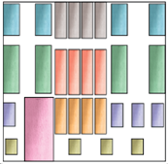
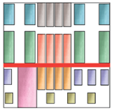
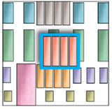
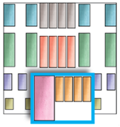
Candidate decomposition selection
Given a box pattern, find all candidates of split and layering
…
Split cand. 1
Split cand. 2
…
Input
Layering cand. 1
Layering cand. 2
Notes:
The next step is candidate decomposition selection, i.e., given a box pattern, or substructure, find all candidates of split and layering

Slide 19
Candidate decomposition selection
Principle 1: An element group can not divided into two components by a valid decomposition
Some examples …
Notes:
We have two principles in candidate selection
Principle 1 is … lets see some examples

Slide 20
Candidate decomposition selection
Examples
Invalid split
Becomes valid after layering
Notes:
For this box pattern, this split is invalid since it passes through the yellow box in the middle
However, if we perform a layering for the middle box first, then the split can be made in the bottom layer

Slide 21
Candidate decomposition selection
Examples
Invalid split
Becomes valid after split
Notes:
Similarly, this split is illegal since it splits the regular grid to the left
If we place such a vertical split first, then in the right substructure, the split becomes valid

Slide 22
Candidate decomposition selection
Examples
Invalid layering
Becomes valid after layering
Notes:
Here is an example on layering
This layering is not allowed since the yellow grid is interrupted by the blue grid,
If blue grid is delayered first, then in the bottom layer, the layering of the yellow grid is valid

Slide 23
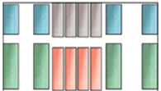
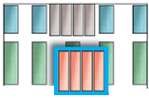
Candidate decomposition selection
Principle 2: Candidate selection is carried out recursively
…
Combinatorial search!
…
Split cand. 1
Split cand. 2
Split cand. 1
…
…
Substructure
Input
Layering cand. 1
Layering cand. 1
Layering cand. 2
Notes:
The second principle is that …
This is easy to understand since what we compute is right a recursive, hierarchical decomposition.
Suppose this is the decomposition that we choose at this level, candidates selection is performed recursively for its substructures..
Apparently, the computation of the optimal decomposition hierarchy involves combinatorial search…

Slide 24
Finding the optimal hierarchy
Genetic algorithm with tree representation
Sample and evolve population of hierarchies
Genetic operators:
Mutation
Crossover
Split
Layering
Altering decomposition
Swapping sub-trees
Notes:
So we resort to genetic algorithm with tree representation to explore the search space and find the optimal solution.
Based on the candidate decompositions we have just computed, we can sample a population of hierarchies and evolve the population to find the optimal hierarchy
The genetic operators, mutation and crossover, are well defined for binary trees

Slide 25
Finding the optimal hierarchy: Genetic algorithm
Fitness function:
$$S_{1}$$
$$S_{3}$$
$$S_{2}$$
$$S_{4}$$
Symmetry measure of a node (a substructure)
$${max. Σ=S_{1}+S_{2}+S_{3}+S}_{4}$$
Notes:
The fitness function is nothing but our objective function, i.e., the sum of symmetry measure at all internal nodes
Now we have talked about most of the major components of our method, the only left thing is the definition of the symmetry measure of a node or a substructure

Slide 26
Symmetry measure at a node
Requirements:
Continuous measure for a discrete box pattern
Behaves well at both ends of the symmetry spectrum
Integral Symmetry (IS):
Integral of symmetry profiles along two directions
X
Perfectly symmetric
asymmetric
Y
Notes:
We require that the symmetry measure should be a continuous measure for a discrete box pattern.
Also, it is supposed to behave well at both ends of the symmetry spectrum, meaning that it should be well-defined for both perfectly symmetric and asymmetric patterns
To this end, we develop the integral symmetry, which is an integral of symmetry profiles along two directions of a box pattern. This symmetry profile reflects the symmetry distribution of the box pattern.

Slide 27
Symmetry measure of a discrete pattern
Symmetry profile – Intra-box profile
$$p_{B}(x)$$
$$B$$
$$o$$
$$X$$
$$x$$
Notes:
So how to compute the symmetry profile for a discrete box pattern?
Symmetry profile is defined for intra-box and inter-box cases, separately. And it is actually an integral of intra-box and inter-box profiles
Let’s first take a look at intra-box profile. Taking the horizontal direction for example, the vertical direction is defined similarly
Suppose we want to compute symmetry measure for a given point, we simply reflect the box wrt the vertical line passing through this point and compute the overlapping area between the box and its reflection as its symmetry measure

Slide 28
Symmetry measure of a discrete pattern
Symmetry profile – Intra-box profile
$$p_{B}(x)$$
$$B$$
$$o$$
$$X$$
$$x$$
Notes:
And for other points, we do the same thing

Slide 29
Symmetry measure of a discrete pattern
Symmetry profile – Intra-box profile
$$B$$
$$p_{B}(x)$$
$$o$$
$$X$$
Notes:
So we obtain a function defined over the horizontal extend of the box, which is a hat function.

Slide 30
Symmetry measure of a discrete pattern
Symmetry profile – Inter-box profile
$$B_{1}$$
$$B_{2}$$
$$p_{B_{1},B_{2}}(x)$$
$$o$$
$$X$$
Notes:
Inter-box profile is similarly defined, just that when we compute the overlapping area, we only account for mutually symmetric boxes

Slide 31
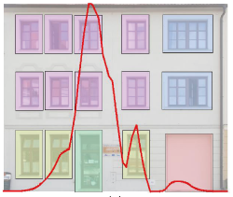
Symmetry measure of a discrete pattern
Combining inter-box and intra-box profiles:
Integral Symmetry
Notes:
Combining both the intra-box and inter-box profiles, we obtain the final symmetry profile for the entire box pattern
Here is the symmetry profile of an example box pattern. It roughly reflects the symmetry distribution of the box pattern.
Our symmetry measure is simply the integral of the profile curves.

Slide 32
An application – Façade retargeting
Top-down propagation
Notes:
An interesting application of our hierarchical representation is structure-aware façade retargeting.
Given a façade and its hierarchical decomposition, suppose we want to resize the façade by dragging its two sizes

Slide 33
An application – Façade retargeting
Top-down propagation
Notes:
With the help of our hierarchy, we perform a top-down editing propagation,
When the resizing reaches the leaf nodes, which are regular grids, we resize them simply by adapting the number of elements in it.

Slide 34
An application – Façade retargeting
Top-down propagation
Notes:
After the propagation is done, the obtain the structure aware retargeting

Slide 35
An application – Façade retargeting
Top-down propagation
input
retargeted

Slide 36
Structure-aware façade retargeting
Notes:
Here is a video showing the structure-aware façade retargeting
As you can see in our system, the user can lock some elements via sketch to protect them from being resized
Without the help of this structural representation, this retargeting would be very hard to achieve

Slide 37
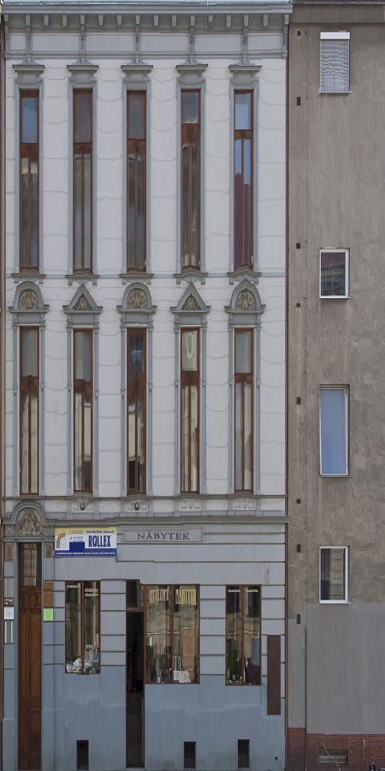
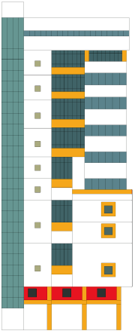
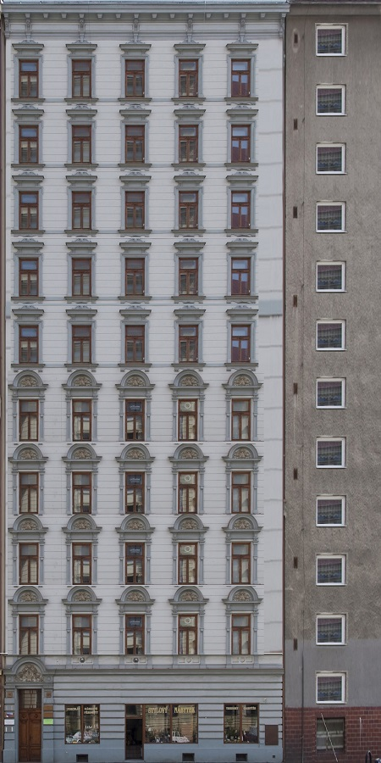
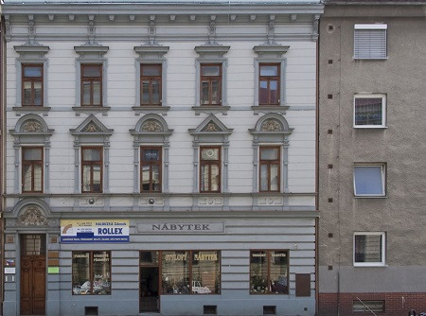
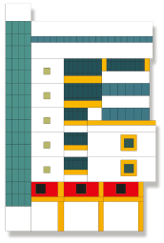
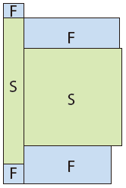
Input
User interactive structural analysis [Lin et al. 2011]
Seam carving
Structure-aware
Notes:
In the work of Lin et al, the authors have studied structure-aware architecture retargeting, but in their work, the hierarchical analysis is performed interactively while in our method this is done automatically.
This is a comparison to content-aware image resizing obtained by seam carving. Apparently, structure-aware retargeting leads to more natural result

Slide 38
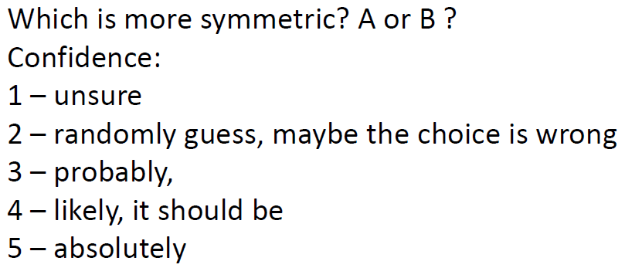
Evaluation I: Integral symmetry
Symmetry ranking tests
A
B
Notes:
Many of the components in our analysis are related to human perception, such as, what is a good symmetry measure of a box patter or what is a natural decomposition,
so we conduct some user studies to evaluate our method
For the integral symmetry, we designed a questionnaire survey where we ask the user to rank the symmetry degree of two box patterns with their confidence

Slide 39
Evaluation I: Integral symmetry
The accuracy score obtained is 88%
Consistent with human perception
Notes:
The result was positive. We obtained an accuracy score of 88% implying that our symmetry measure is mostly consistent with human perception

Slide 40
Evaluation II: Symmetry-driven decomposition
Our method
max.
$$\text{SymScore}(c_{1})$$
$$\text{SymScore}(c_{2})$$
Notes:
We also evaluate our method of box pattern decomposition. Our decomposition is based on symmetry maximization.

Slide 41
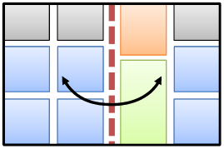
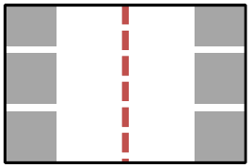
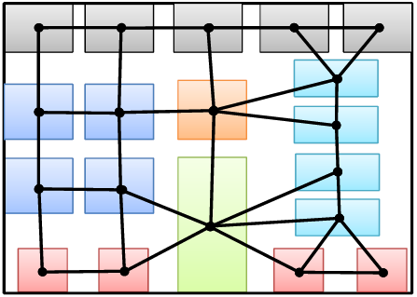
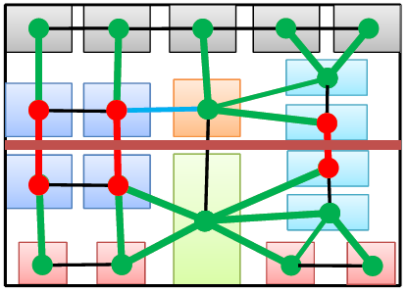
Evaluation II: Symmetry-driven decomposition
Compare to two alternatives
Alternative 1:
Alternative 2:
Global reflectional symmetry
Graph-cut segmentation
Notes:
We compare our method with two alternatives.
One is based on global reflectional symmetry. In this method, we only consider splits. The optimal split is selected so that the box pattern, when being reflected about the split line, overlaps the most with its reflection
The other one is essentially a graph-cut segmentation. For more details about it, please refer to the paper

Slide 42
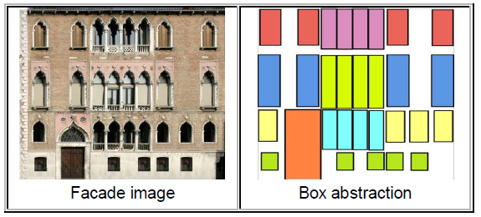
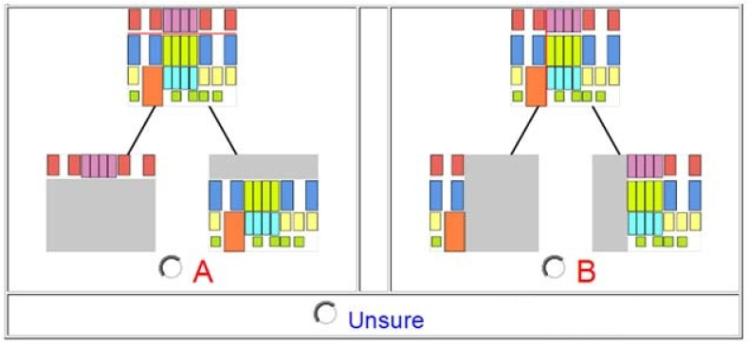
Evaluation II: Symmetry-driven decomposition
Please select which one, A or B, appears to offer the best high-level explanation of the facade structure:
Notes:
In the user study, we present the user with a box pattern of a facade along with two decompositions, one of them is the result of our method, and the other one is computed by one of the two alternatives. We let the user select which one of the two appears to offer the best high-level explanation of the façade structure

Slide 43
Evaluation II: Symmetry-driven decomposition
On 600 questions
Obtain a winning percentage
of 73% against Alternative 1
of 79% against Alternative 2
Notes:
The uses’ selections were mostly favoring to our method. We obtain a

Slide 44
Limitations
Box abstraction and element grouping carried out with user assistance
Limited to axis-aligned structures
Limited to binary decompositions
Human perception related
learning/crowdsourcing?

Slide 45
Conclusion
Hierarchical and layered analysis of irregular facades
Generative model: hierarchy of decompositions
A clearly defined objective: symmetry maximization
Applications:
Structure-aware façade retargeting/editing/exploration
Notes:
To summarize, we have studied the hierarchical and layered analysis of irregular facades,
Such an analysis leads to a generative model, i.e. a hierarch of decompositions
Also, we have a clearly defined objective based on symmetry maximization
We have some interesting applications such as structure aware … If you are interested in the last two applications, please refer to our paper

Slide 46
Acknowledgement
Anonymous reviewers
Yangyan Li, Niloy Mitra, and Ariel Shamir
Participants of our user studies
Research grants
NSERC Canada, NSFC China, Guangdong Sci. and Tech. Program, Shenzhen Sci. and Inno. Program, CPSF, and the Israel Science Foundation.

Slide 47
Thank you!
Code and data are available: kevinkaixu.net
Notes:
The code and data of our paper are available online..
Thank you for your attention!

